Slide 1
Safety Trained
Supervisor Certifications: STS and STSC
Presenter:
Title:
Company:

Slide 2
Overview
About the Safety Trained Supervisor® (STS®) and Safety Trained Supervisor Construction® (STSC®) certifications
Benefits of BCSP certification
STS and STSC requirements and application process
About the Board of Certified Safety Professionals ® (BCSP ®)
Notes:
The Safety Trained Supervisor (STS) is intended for leaders at all levels of an organization because all employees have responsibilities for a safe work environment. This certification is intended for executives, directors, managers, supervisors, superintendents, and employees. These individuals may not have safety as a primary duty, but their knowledge of safety practices ensures safer and healthier worksites, and their competency strengthens the foundation of safety in the organization. The STS sets standard baseline knowledge across the organization.
More information can be found in our Path to Success Guide (https://online.fliphtml5.com/pbcyp/feqw/#p=1)
The Safety Trained Supervisor Construction (STSC) is intended for leaders at all levels of an organization because all employees have responsibilities for a safe work environment. This certification is intended for executives, directors, managers, supervisors, superintendents, and employees. These individuals may not have safety as a primary duty, but their knowledge of safety practices ensures safer and healthier worksites, and their competency strengthens the foundation of safety in the organization. The STS sets standard baseline knowledge across the organization.
More information can be found in our Path to Success Guide (https://online.fliphtml5.com/pbcyp/feqw/#p=1)

Slide 3
What are the STS/STSC Certifications
Certification for leaders at all levels of an organization.
All employees are responsible for a safe work environment
Intended for executives, directors, managers, supervisors, superintendents, and employees
May not have safety as a primary duty, but their knowledge ensures safer worksites
Notes:
STS and STSC are intended for leaders at all levels of an organization because all employees have responsibilities for a safe work environment. This certification is intended for executives, directors, managers, supervisors, superintendents, and employees. These individuals may not have safety as a primary duty, but their knowledge of safety practices ensures safer and healthier worksites, and their competency strengthens the foundation of safety in the organization. The STS sets standard baseline knowledge across the organization.

Slide 4
Job Titles and Duties
JOB TITLES
JOB DUTIES
Safety Coordinator
Safety Supervisor
Oversight Safety Supervisor
Safety Committee Member
Construction Safety Supervisor
Safety Project Manager
Plan work and manage cross-functional hazards associated with a project
Address changing conditions or tasks in the job safety/hazard analysis process
Effectively communicate findings of audits or inspections
Effectively communicate safety information to employees
Notes:
Are leaders at any level.
Have safety responsibilities that are part of other work duties.
Have safety responsibilities that are adjunct, collateral, or ancillary to their job duties. Their main job duties are in a craft or trade, a technical specialty, supervision, management, or leadership.
Safety tasks often include monitoring for job hazards, helping ensure regulatory compliance, training employees in safety practices, performing safety documentation tasks, coordinating corrections for identified safety hazards within or among work groups, and communicating with safety specialists or management.

Slide 5
Supervisory Certifications
Safety Trained Supervisor
Safety Trained Supervisor Construction
Notes:
Difference between STS and STSC :
People who purse the STS generally work in transportation, utilities, and manufacturing. The program also includes workers in facility services, health care social assistants, administrative and support management, and maintenance.
STSC is intended for construction supervisors, managers, superintendents, forepersons, crew chiefs, and craftspeople who have responsibilities to maintain safe conditions and practices on construction job sites.
BCSP awards technician and supervisory SH&E certifications that provide career paths for safety practitioners.
People at the technical level:
Typically have either considerable safety and health training through a series of courses, or have an associate degree or higher.
May have part-time or full-time safety and health responsibilities.
For small companies, safety is often assigned to an employee who also has other job functions for the company or within a work unit.
They are making work site assessments to determine risk, identifying potential hazards and recommending controls, evaluating risks and hazard control measures, investigating accidents, maintaining and evaluating incident and loss records, and preparing emergency response plans.
Typically conduct safety, health and environmental training for employees.
People at the supervisory level:
Receive training through employer-sponsored or supported courses.
This training typically extends beyond the safety of a particular craft or job function to more general safety or work places, conditions and practices.
Are often involved in safety and health activities by serving on department, plant, or union-safety committees.
Have responsibility for coworkers under their direct supervision.
As of September 30, 2020:
STS: 2,499
STSC: 7,112
Only one other accredited certifications exists for SH&E practitioners at the technologist, technician and supervisory levels through ANAB and ICE.

Slide 6
STS & STSC Program Growth
STS & STSC Certification Holders

Slide 7
Targeted Toward:
Supervisors
Crew Chiefs
Foremen
Future Supervisory Candidates
Group Leaders
Safety Committee Members
Departmental Safety Liaisons/Champions
Leadership
Senior Executives
Managers at all levels within the organization

Slide 8
Supervisors — Why?
Available resource
Skilled craft worker
Closest to work environment
Know their personnel
May have worked for a poor leader
Inadequate/NO training
Failure to correct known problems
Inappropriate planning
Put workers/company at risk
Supervisor violations
Inadequate leadership knowledge/training
Production/intimidation focus
Notes:
Companies with exceptional safety processes and proactive leadership fully understand that SAFETY is, has, and will always be a function of line management.
As Safety Professionals it is our obligation and responsibility to use every available resource to get our workers home safe each and every day.

Slide 9
Why Supervisor Focus?
Senior leadership =
processes, procedures, support/promotion
Line management =
where safety happens
Notes:
Companies with exceptional safety processes and proactive leadership fully understand that SAFETY is, has, and will always be a function of line management.
As Safety Professionals it is our obligation and responsibility to use every available resource to get our workers home safe each and every day.

Slide 10
Companies that strive for and sustain SAFETY EXCELLENCE understand that front line supervisors are an ACTIVE & CRITICAL part of a successful safety process.

Slide 11
Benefits of Certification
ACCOMPLISHMENT
VALIDATION
OPPORTUNITIES
COMPETITION
RECOGNITION
DEMONSTRATES THAT SAFETY IS EVERYBODY’S JOB
Notes:
Hiring Preferences and Salary Increases: Advertisements for safety professionals often identify the CSP certification or other BCSP credentials as a desired or required qualification along with education and experience. Human resource managers and those hiring people for government positions depend on professional certification to ensure candidates have met minimum qualifications.
Enhance Your Self-Esteem: The most frequent reported value derived from achieving a BCSP credential is increased self-esteem and personal satisfaction. Most newly-certified individuals report that achieving their certification increases their personal worth. A major factor is having met standards established by peers for professional safety practice. It indicates that you have risen above the competition because you have been evaluated by professional peers against those standards.
Share Your Knowledge for Professional Safety Practice: Having achieved a certification shows you have mastered the core knowledge required for professional safety practice. The Safety Salary Survey shows that the certification process provided them with appropriate qualifications in the field. The certification did what it is intended to do - ensured the knowledge necessary for practice.
Gain an Advantage Over Your Peers: Due to the high quality of BCSP credentials, as demonstrated by its compliance with national and/or internationally recognized standards for certification of persons, most holding a BCSP credential have created an edge for themselves. As recognition for BCSP credentials grow among employers, government agencies, peers, and the public; those holding one have a competitive advantage for safety positions and assignments.
Personal accomplishment
Validation of competency in safety management
Expands opportunities for qualified safety practitioners
More competitive in obtaining jobs, promotions
Recognizes contributions of non full-time safety practitioners
Demonstrates that safety is everybody’s job
Certification also reflects an individuals:
* Dedication to their colleagues’ safety
* Responsibility as a leader
* Desire for accountability

Slide 12
Benefits of Certification
Employers and Owners
Helpful in selecting qualified safety professional
Improves safety in the workplace through increased competence and confidence
Increases public confidence in the employer’s safety program
Enhances profitability and quality by reducing accidents, illnesses, and insurance claims
Notes:
Achieving certification is important because it demonstrates your level of competency in the safety, health, and environmental (SH&E) fields. Certifications advance safety professionalism, and they provide a competitive advantage for the certificate holder. It’s also important to remember that credentials like the ones BCSP offers demonstrate credibility in your chosen field, and they set the standard for safety that helps keep everyone safe in the workplace. A BCSP certification can also lead to better pay and job mobility, as possessing a greater knowledge base and having more experience can lead to better careers in safety.

Slide 13
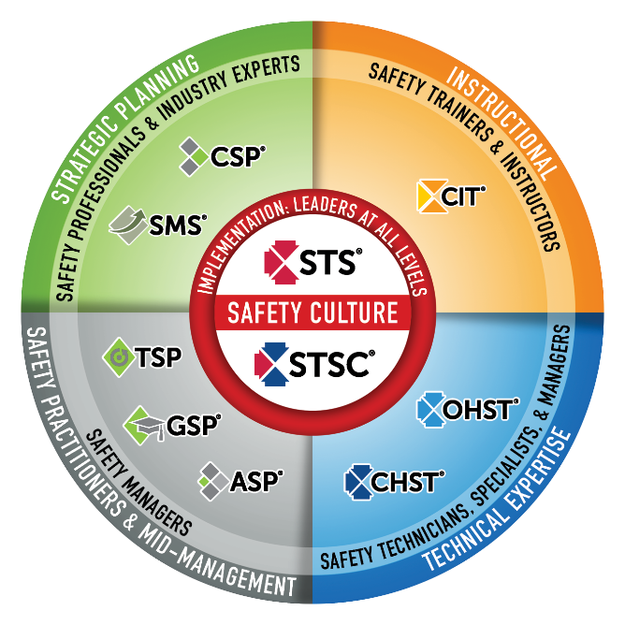
Safety Culture
BCSP fulfills industry and global demand for validating highly competent safety practitioners with varying amounts of formal education and significant amounts of experience.
BCSP certifications create a unified safety culture by setting baseline competencies of safety knowledge and skills throughout the organization.
The best safety cultures require safety competency across the organization and also value safety leadership at all levels.
Notes:
BCSP Safety Certification Continuum
This graphic is a good way to convey the differences between BCSP’s certifications. It shows the correlation between each and in which fields the credentials are most useful.
BCSP credentials create a unified safety culture by setting baseline competencies of safety knowledge and skills throughout organizations.
The need for safety exists at all levels of an organization. The best safety cultures require safety competency across the organization and value safety leadership at all levels.

Slide 14
The Certification Process
Notes:
All BCSP certifications are different, but the process of achieving and maintaining them is the same. This graphic offers a quick overview of the process. A greater explanation can be found in the Complete Guide (https://online.fliphtml5.com/pbcyp/ijfs)

Slide 15
&
Eligibility Requirements
Training Requirement
30 hours of formal safety-related training
Experience Requirement
Two (2) years supervisory experience; OR
Four (4) years work experience (work experience must be a minimum part-time [18 hrs/week] to qualify); OR
An associate degree or higher in Occupational Safety, Risk Management, or Construction Management; OR
Completion of a 2-year trade or union training program/apprenticeship.
Ethics
Commitment to the BCSP Code of Ethics

Slide 16
Examination and Fees
Exams are taken at Pearson VUE’s test centers located around the world http://www.vue.com/bcsp/
Two-hour exam with 100 multiple choice questions
Fees
Application fee
Exam fee
Annual renewal
Notes:
Fees
Application: $120
Exam: $185
Exam Bundle: $325
Annual Renewal: $70

Slide 17
Now Offering an Exam Bundle!
REDUCE STRESS
WITH A 2ND CHANCE TEST!
Exam bundles include an examination authorization, an online self-assessment, and a second exam attempt if the first is unsuccessful for one reduced price.
Apply Today @
Notes:
Applicants who are exam-eligible may select "Purchase Exam" and choose to buy an exam bundle.
CSP, SMS, ASP: Exam $350. Bundle $600.
OHST, CHST: Exam $300. Bundle $550.
STS, STSC: Exam $185. Bundle $325.
CIT: Exam $300. Bundle $500
-Each examination authorization is good for an exam sitting, is non-transferable and non-refundable.
-You must have at least thirteen (13) weeks left on your eligibility time clock to purchase the Exam Bundle.
-Applicants must wait a six (6) week period between exam attempts if a second attempt is needed.

Slide 18
&
Recertification Requirements
Attend and/or teach 30 hours during the five-year cycle
Safety and health courses
Presentations
Tool-box talks
OR
Achieve the CSP, SMS, ASP, OHST, CHST, STS, STSC, or CIT during the five-year cycle
Notes:
You can receive recertification points for achieving other (BCSP-approved) credentials. For the full listing of accepted credentials and to find details on how to calculate points earned, see the BCSP Recertification Guide online at: https://www.bcsp.org/safety-certifications/recertification
Examples of accepted credentials include:
25 points: CSP, ASP, CRSP, CMIOSH, SISO
20*: points: CHST, OHST (*STSs, STSCs, OHSTs, CHSTs, and CITs will receive 20 points for obtaining the OHST or CHST)
15 points: Certified Dangerous Goods Professional
5 points: STS, STSC
3 points: CIT

Slide 19
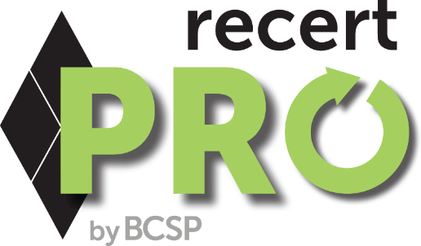
An online platform for certification holders to earn recertification points!
recertPRO.COM
Notes:
BCSP recertPRO is a new, affordable way to earn BCSP recertification points from the convenience of your own computer or mobile device--giving you a convenient way to earn recertification points on your own schedule!
BCSP recertPRO is available for an annual subscription of $499.
BCSP recertPRO combines Challenge Tests, the KSA Quest (Knowledge, Skills, and Abilities Quest), and Journal Quizzes into a responsive website for an opportunity to achieve 6.85 recertification points per year:
0.1 points per Journal Quiz, with 41 available, for 4.1 points total. 0.25 points per KSA, with five (5) available, for 1.25 points total. A set of 1-point and 0.5-point Challenge Tests, for 1.5 points total.

Slide 20
Group Management
INVEST IN SAFETY FOR YOUR WHOLE ORGANIZATION
Cover fees for employee/member pursuit of BCSP certifications and designations
Ensure a high standard of safety throughout all levels
Company name and website link on BCSP website
PROVEN EFFECTIVE
Eldeco, Inc
31% reduction in injuries
50% decrease in overall workers compensation claims costs
Nicholson Construction
Reduced company’s total recordable rate from 10.27 to 1.66 over 5 years
Hensel Phelps
Recordable incident rate ½ the industry average
Notes:
Any organization such as a union, construction firm, project owner or government agency, can join Group Management. Organizations who joined Group Management say it has given them a competitive edge and helped promote safety awareness and training.
Group Account Managers (GAMs) will be able to pay for exams, exam bundles (which include self-assessments), and all other products and services. BCSP examCORE, recertPRO, and stand-alone online self-assessments are currently excluded.

Slide 21
About BCSP: Credentialing Leader
History of excellence
Exceptional standards of governance
Integrity in exam process
International recognition
Maintains highest standards of accreditation
50,000+ active certifications/designations in 108 countries
Notes:
BCSP is recognized as the leader in high-quality credentialing for safety, health, and environmental practitioners.
BCSP establishes standards for and verifies competency in professional safety practices and evaluates certificants for compliance with recertification requirements.
One of the longest-running professional credentialing bodies for SH&E professionals in the world
CRSP- 1976
IOSH didn’t begin issuing Chartered S&H Practitioner Status until 2005
Only ABIH is older than us (first CIHs issued in 1952)
History
Established in 1969
More than 58,000 credential holders across 108 countries since 1969
Not-For-Profit — headquartered in Indianapolis, IN
Mission-driven: We inspire and develop leaders in safety, health, and environmental practice through globally accredited certification; enhancing careers, advancing the profession, protecting people
Vision: A safer world through safety, health, and environmental leadership.
Standards of Governance
9 - 14 Member Board of Directors
8 Sponsorship Organizations to ensure governance of BCSP includes broad representation from across the safety profession
AIHA, ASSP, NSC, NFPA, SFPE (Society of Fire Protection Engineers), IISE, ISSS, NESHTA
Integrity in Exam Process
Psychometric process:
Ensures all exams meet the highest standards when it comes to accurately reflecting the most relevant tasks, knowledge and skills required for current professional safety practice;
Ensures items are well-written, extensively reviewed, are reliable and valid
Ensures regular review occurs (revalidation)- occurs every 4-5 years
Widespread recognition
BCSP is recognized as the leader in high-quality credentialing for safety, health, and environmental practitioners.
The CSP is the “gold standard” worldwide
BCSP is actively involved internationally with defining and expanding the safety profession (will talk more about our relationships/collaborations with international safety organizations later, such as INSHPO)
Recognized by international bodies:
UN (Special Consultative Status with ECOSOC)
ISO
International safety certification boards
Accreditation: and not just any accreditation; BCSP follows the highest standards for accreditation, as set by the ISO
58,496 active certifications/designations in 108 countries around the world (as of November 30, 2021).

Slide 22
We Are BCSP: Inspiring a Safer World

Slide 23
About BCSP
Established in 1969
Not-For-Profit — headquartered in Indianapolis, IN
9 – 14 Directors on the Board
Not a membership organization
Internationally Recognized
Notes:
Headquartered in Indianapolis, IN, USA, the Board of Certified Safety Professionals (BCSP) is a not-for-profit corporation recognized as a leader in high-quality, accredited credentialing for safety, health, and environmental (SH&E) practitioners.
BCSP currently offers 8 certifications and recently celebrated 50 years of excellence in safety credentialing. These certifications are designed to set and certify technical competency criteria for SH&E practitioners worldwide. Together, we can create a safer world through safety, health, and environmental leadership.

Slide 24
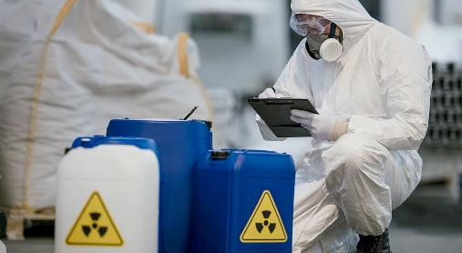
About BCSP
MISSION
We inspire and develop leaders in, health, and environmental practice through globally accredited certification; enhancing careers, advancing the profession, protecting people.
VISION
A safer world through safety, health, and environmental leadership.
CORE VALUES
BCSP – Be respectful, Create positive cultures, Serve as leaders, Protect others
Notes:
Since 1969, the Board of Certified Safety Professionals (BCSP) has been setting and certifying the technical competency criteria for safety, health, and environmental practitioners.
In that time, many joined us as pioneers, improving safety practice by meeting the challenge of achieving and maintaining quality, accredited safety certification—The Gold Standard.
As BCSP begins the second half of our first century as an organization, what we have built has rewarded us with many new and exciting opportunities to advance safety. As we head into the future, we will ensure no one is left behind. BCSP will continue to create the path forward.

Slide 25
About BCSP: 8 Endorsing Organizations
AIHA® - American Industrial Hygiene Association® (1974)
ASSP - American Society of Safety Professionals (1974)
IISE - Institute of Industrial and Systems Engineers (1994)
ISSS - International System Safety Society (1977)
NESHTA - National Environmental, Safety and Health Training Association (2012)
NFPA - National Fire Protection Association (2007)
NSC - National Safety Council (1994)
SFPE - Society of Fire Protection Engineers (1984)
Notes:
These organizations ensure that governance of BCSP includes broad representation from across the safety profession.
Affiliated endorsing organizations nominate individuals to serve on the BCSP Board of Directors. These organizations do not provide funding or support to BCSP or its operations. They do provide their members with a variety of member services, including journals, conferences, continuing education courses, books, and many other valuable services for safety professionals.
The current affiliated endorsing organizations are listed along with the year in which they began their participation with BCSP.

Slide 26
Training from the source
Your path to success
Industry leading instructors
examCORE.ORG
Notes:
CSP, SMS, ASP, OHST, and CHST available now. $999 for 6 months access
Each training includes: 40+ subject areas, 1000+ questions
STS and STS available now. $499 for 6 months access.
Each training includes: 30+ subject areas, and 500+ questions
CIT available now. $699 for 6 months access.
Includes: 30+ subject areas, and 700+ questions
ASP + CSP examCORE Connect gives access to both training courses. $1,899 for 9 months access. Connect training includes: 40+ subject areas, 2,000+ questions

Slide 27
What are you willing to do to make a difference?

Slide 28
Questions?

Slide 29
Thank you!
Presenter:
Title:
Company:

