Slide 1

Construction Health and Safety Technician
Presenter:
Title:
Company

Slide 2


Overview
About the Construction Health and Safety® (CHST®) certification
Benefits of BCSP certification
CHST requirements and application process
About the Board of Certified Safety Professionals® (BCSP ®)
Notes:
The Construction Health and Safety Technician (CHST) certification is designed for individuals who demonstrate competency and work part-time or full-time in health and safety activities devoted to the prevention of construction illnesses and injuries. The CHST certification meets national standards for certifications.
Candidates for the CHST certification are typically employed as safety and health specialists on construction job sites, serving in either full-time or part-time positions. Typical individuals are responsible for safety and health on one or more significant construction projects or job sites. They may work for an owner, general contractor, subcontractor, or firm involved in construction or construction safety.
The CHST program recognizes that many employers assign responsibility for construction safety and health functions to those with very important roles in protecting workers. Many construction safety professionals use the CHST as a stepping-stone to greater roles in safety and health and, in some cases, to the Certified Safety Professional (CSP) certification.
More information can be found in our Path to Success Guide (https://online.fliphtml5.com/pbcyp/feqw)

Slide 3

What is the CHST Certification?
Certification for individuals who work in health and safety activities devoted to the prevention of construction illnesses and injuries
  Safety and health specialists on
  construction job sites
  Working on one or more significant construction projects or job sites
Notes:
BCSP awards technician and supervisory SH&E certifications that provide career paths for safety practitioners.
As of November 30, 2021:
CHST: 9,214
People at the technical level:
typically have either considerable safety and health training through a series of courses or have an associate degree or higher.
May have part-time or full-time safety and health responsibilities.
For small companies, safety is often assigned to an employee who also has other job functions for the company or within a work unit.
They are making work site assessments to determine risk, identifying potential hazards and recommending controls, evaluating risks and hazard control measures, investigating accidents, maintaining and evaluating incident and loss records, and preparing emergency response plans.
Typically conduct safety, health and environmental training for employees.

Slide 4

What is the CHST Certification?
Competency assessment focused on:
  Construction health and safety
  Risk management
  SH&E concepts
  Incident investigation and
  emergency preparedness
  Business case of safety
Notes:
This is the professional credential for the safety practitioner with technical experience, with or without a college degree
Most certificants who hold the CHST work in building construction or the general contracting sector; they may also work in the heavy and civil engineering sector. Safety at this level is virtually in every industry including manufacturing, petroleum production and refining, construction, and insurance. An SMS may hold positions at the manager level or director level and may directly supervise employees.
The primary qualification is linked to experience, The exam for this certification tests skills at a different level (than say ASP or CSP)

Slide 5
Job Titles and Duties
JOB TITLES
JOB DUTIES
Safety Manager
Safety Supervisor
SH&E Technician
Safety Director
Construction Safety Specialist
Corporate Safety Director
Safety Leader
Site Safety Coordinator
Apply hierarchy of controls to various types of hazards
Verify effectiveness in corrective actions
Recognize and address hazards over changing construction site conditions
Develop job/hazard safety analyses
Plan for emergencies
Notes:
Many safety managers that this certification targets did not follow a “linear” career path
The certification tends to be people who came up through industry and now (successfully) run the safety programs
These kinds of safety managers have broad-based knowledge that make them effective managers, as opposed to specific technical areas of expertise
Extremely common to see (especially in smaller organizations) employees that wear many “hats” including that of safety manager
Ex: HR Manager that also does Quality Control and Safety
VP Operations, which includes OSH responsibilities and oversight
Hence the “part-time” safety role
Great option for military transitioning to civilian careers
Individuals in these roles often train young professionals entering the field. Thus, their influence within the profession extends to the next generation.

Slide 6

Benefits of Certification
ACCOMPLISHMENT
VALIDATION
OPPORTUNITIES
COMPETITION
RECOGNITION
DEMONSTRATES THAT SAFETY IS EVERYBODY’S JOB
Notes:
Hiring Preferences and Salary Increases: Advertisements for safety professionals often identify the CSP certification or other BCSP credentials as a desired or required qualification along with education and experience. Human resource managers and those hiring people for government positions depend on professional certification to ensure candidates have met minimum qualifications.
Enhance Your Self-Esteem: The most frequent reported value derived from achieving a BCSP credential is increased self-esteem and personal satisfaction. Most newly-certified individuals report that achieving their certification increases their personal worth. A major factor is having met standards established by peers for professional safety practice. It indicates that you have risen above the competition because you have been evaluated by professional peers against those standards.
Share Your Knowledge for Professional Safety Practice: Having achieved a certification shows you have mastered the core knowledge required for professional safety practice. The Safety Salary Survey shows that the certification process provided them with appropriate qualifications in the field. The certification did what it is intended to do - ensured the knowledge necessary for practice.
Gain an Advantage Over Your Peers: Due to the high quality of BCSP credentials, as demonstrated by its compliance with national and/or internationally recognized standards for certification of persons, most holding a BCSP credential have created an edge for themselves. As recognition for BCSP credentials grow among employers, government agencies, peers, and the public; those holding one have a competitive advantage for safety positions and assignments.
Personal accomplishment
Validation of competency in safety management
Expands opportunities for qualified safety practitioners
More competitive in obtaining jobs, promotions
Recognizes contributions of non full-time safety practitioners
Demonstrates that safety is everybody’s job
Certification also reflects an individuals:
* Dedication to their colleagues’ safety
* Responsibility as a leader
* Desire for accountability

Slide 7

Benefits of Certification
Employers and Owners
Helpful in selecting qualified safety professional
Improves safety in the workplace through increased competence and confidence
Increases public confidence in the employer’s safety program
Enhances profitability and quality by reducing accidents, illnesses, and insurance claims
Notes:
Achieving certification is important because it demonstrates your level of competency in the safety, health, and environmental (SH&E) fields. Certifications advance safety professionalism, and they provide a competitive advantage for the certificate holder. It’s also important to remember that credentials like the ones BCSP offers demonstrate credibility in your chosen field, and they set the standard for safety that helps keep everyone safe in the workplace. A BCSP certification can also lead to better pay and job mobility, as possessing a greater knowledge base and having more experience can lead to better careers in safety.

Slide 8
CHST Growth
CHST Certification Holders
Notes:
BCSP currently has nearly 60,000 certificants total.

Slide 9
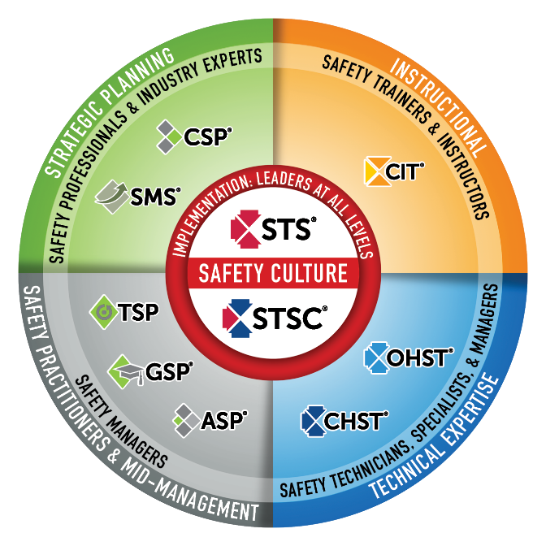

Safety Culture
BCSP fulfills industry and global demand
for validating highly competent safety practitioners with varying amounts of formal education and significant amounts of experience.
BCSP certifications create a unified safety culture by setting baseline competencies of safety knowledge and skills throughout the organization.
The best safety cultures require safety competency across the organization and also value safety leadership at all levels.
Notes:
BCSP Safety Certification Continuum
This graphic is a good way to convey the differences between BCSP’s certifications. It shows the correlation between each and in which fields the credentials are most useful.
BCSP credentials create a unified safety culture by setting baseline competencies of safety knowledge and skills throughout organizations.
The need for safety exists at all levels of an organization. The best safety cultures require safety competency across the organization and value safety leadership at all levels.

Slide 10

The Certification Process
Notes:
All BCSP certifications are different, but the process of achieving and maintaining them is the same. This graphic offers a quick overview of the process. A greater explanation can be found in the Complete Guide (https://online.fliphtml5.com/pbcyp/ijfs)

Slide 11



Eligibility Requirements
Experience Requirement
  Have 3 years of experience with 35% of primary job duties in construction-related safety and health
Ethics
  Commitment to the BCSP Code of Ethics
Notes:
People at the technical level:
typically have either considerable safety and health training through a series of courses or have an associate degree or higher.
May have part-time or full-time safety and health responsibilities.
For small companies, safety is often assigned to an employee who also has other job functions for the company or within a work unit.
They are making work site assessments to determine risk, identifying potential hazards and recommending controls, evaluating risks and hazard control measures, investigating accidents, maintaining and evaluating incident and loss records, and preparing emergency response plans.
Typically conduct safety, health and environmental training for employees.

Slide 12

Examination and Fees
Exams are taken at Pearson VUE’s test centers located around the world http://www.vue.com/bcsp/
Four-hour exam with 200 multiple choice questions
Fees
  Application fee
  Exam fee
  Annual renewal
Notes:
Fees
Application: $140
Exam: $300
Exam Bundle: $550
Annual Renewal: $145

Slide 13


Now Offering an
Exam Bundle!
REDUCE STRESS
WITH A 2ND CHANCE TEST!
Exam bundles include an examination authorization, an online
self-assessment, and a second exam attempt if the first is unsuccessful for one reduced price.
Apply Today @
Notes:
Applicants who are exam-eligible may select "Purchase Exam" and choose to buy an exam bundle.
CSP, SMS, ASP: Exam $350. Bundle $600.
OHST, CHST: Exam $300. Bundle $550.
STS, STSC: Exam $185. Bundle $325.
CIT: Exam $300. Bundle $500
-Each examination authorization is good for an exam sitting, is non-transferable and non-refundable.
-You must have at least thirteen (13) weeks left on your eligibility time clock to purchase the Exam Bundle.
-Applicants must wait a six (6) week period between exam attempts if a second attempt is needed.

Slide 14
Recertification Requirements
20 points every 5 years
10 point categories (some with point limitations)
  Professional Safety Practice
  Membership in Safety Organizations
  Organizational Service
  Publications, Conference Presentations,
  and Patents
  Service to BCSP
  Professional Development Conferences
  Safety-related Course or Seminar,
  Other Educational Program, Certificates, Readership Quiz Program, and BCSP Online Quiz
  College or University Courses
  Advanced Degree
  Additional Certification or License
Notes:
You can receive recertification points for achieving other (BCSP-approved) credentials. For the full listing of accepted credentials and to find details on how to calculate points earned, see the BCSP Recertification Guide online at: https://www.bcsp.org/safety-certifications/recertification
Examples of accepted credentials include:
25 points: CSP, ASP, CRSP, CMIOSH, SISO
20*: points: CHST, OHST (*STSs, STSCs, OHSTs, CHSTs, and CITs will receive 20 points for obtaining the OHST or CHST)
15 points: Certified Dangerous Goods Professional
5 points: STS, STSC
3 points: CIT

Slide 15

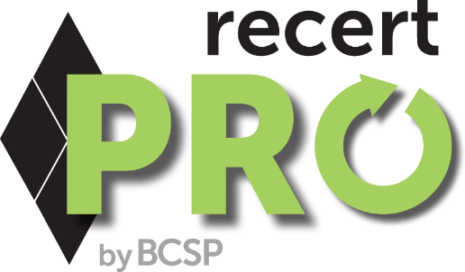
An online platform for certification
holders to earn recertification points!
recertPRO.COM
Notes:
BCSP recertPRO is a new, affordable way to earn BCSP recertification points from the convenience of your own computer or mobile device--giving you a convenient way to earn recertification points on your own schedule!
BCSP recertPRO is available for an annual subscription of $499.
BCSP recertPRO combines Challenge Tests, the KSA Quest (Knowledge, Skills, and Abilities Quest), and Journal Quizzes into a responsive website for an opportunity to achieve 6.85 recertification points per year:
0.1 points per Journal Quiz, with 41 available, for 4.1 points total.
0.25 points per KSA, with five (5) available, for 1.25 points total.
A set of 1-point and 0.5-point Challenge Tests, for 1.5 points total.

Slide 16
Group Management
INVEST IN SAFETY FOR YOUR WHOLE ORGANIZATION
Cover fees for employee/member pursuit of BCSP certifications and designations
Ensure a high standard of safety throughout all levels
Company name and website link on BCSP website
PROVEN EFFECTIVE
Eldeco, Inc
31% reduction in injuries
50% decrease in overall workers compensation claims costs
Nicholson Construction
Reduced company’s total recordable rate from 10.27 to 1.66 over 5 years
Hensel Phelps
Recordable incident rate ½ the industry average
Notes:
Any organization such as a union, construction firm, project owner or government agency, can join Group Management. Organizations who joined Group Management say it has given them a competitive edge and helped promote safety awareness and training.
Group Account Managers (GAMs) will be able to pay for exams, exam bundles (which include self-assessments), and all other products and services. BCSP examCORE, recertPRO, and stand-alone online self-assessments are currently excluded.

Slide 17


About BCSP:
Credentialing Leader
History of excellence
Exceptional standards of governance
Integrity in exam process
International recognition
Maintains highest standards of accreditation
50,000+ active certifications/designations
in 108 countries
Notes:
BCSP is recognized as the leader in high-quality credentialing for safety, health, and environmental practitioners.
BCSP establishes standards for and verifies competency in professional safety practices and evaluates certificants for compliance with recertification requirements.
One of the longest-running professional credentialing bodies for SH&E professionals in the world
CRSP- 1976
IOSH didn’t begin issuing Chartered S&H Practitioner Status until 2005
Only ABIH is older than us (first CIHs issued in 1952)
History
Established in 1969
More than 58,000 credential holders across 108 countries since 1969
Not-For-Profit — headquartered in Indianapolis, IN
Mission-driven: We inspire and develop leaders in safety, health, and environmental practice through globally accredited certification; enhancing careers, advancing the profession, protecting people
Vision: A safer world through safety, health, and environmental leadership.
Standards of Governance
9 - 14 Member Board of Directors
8 Sponsorship Organizations to ensure governance of BCSP includes broad representation from across the safety profession
AIHA, ASSP, NSC, NFPA, SFPE (Society of Fire Protection Engineers), IISE, ISSS, NESHTA
Integrity in Exam Process
Psychometric process:
Ensures all exams meet the highest standards when it comes to accurately reflecting the most relevant tasks, knowledge and skills required for current professional safety practice;
Ensures items are well-written, extensively reviewed, are reliable and valid
Ensures regular review occurs (revalidation)- occurs every 4-5 years
Widespread recognition
BCSP is recognized as the leader in high-quality credentialing for safety, health, and environmental practitioners.
The CSP is the “gold standard” worldwide
BCSP is actively involved internationally with defining and expanding the safety profession (will talk more about our relationships/collaborations with international safety organizations later, such as INSHPO)
Recognized by international bodies:
UN (Special Consultative Status with ECOSOC)
ISO
International safety certification boards
Accreditation: and not just any accreditation; BCSP follows the highest standards for accreditation, as set by the ISO
58,496 active certifications/designations in 108 countries around the world (as of November 30, 2021).

Slide 18
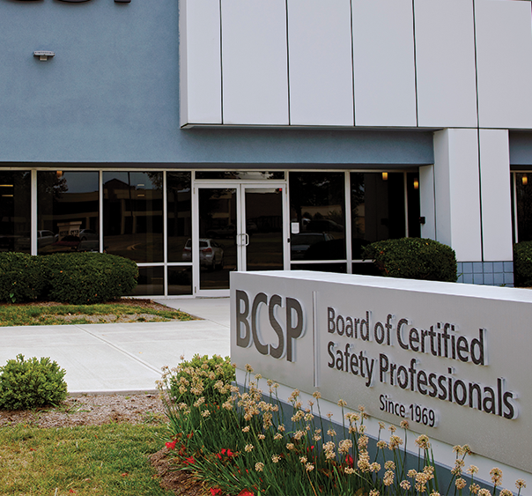
About BCSP
Established in 1969
Not-For-Profit —
headquartered in Indianapolis, IN
9 – 14 Directors on the Board
Not a membership organization
Internationally Recognized
Notes:
Headquartered in Indianapolis, IN, USA, the Board of Certified Safety Professionals (BCSP) is a not-for-profit corporation recognized as a leader in high-quality, accredited credentialing for safety, health, and environmental (SH&E) practitioners.
BCSP currently offers 8 certifications and recently celebrated 50 years of excellence in safety credentialing. These certifications are designed to set and certify technical competency criteria for SH&E practitioners worldwide. Together, we can create a safer world through safety, health, and environmental leadership.

Slide 19
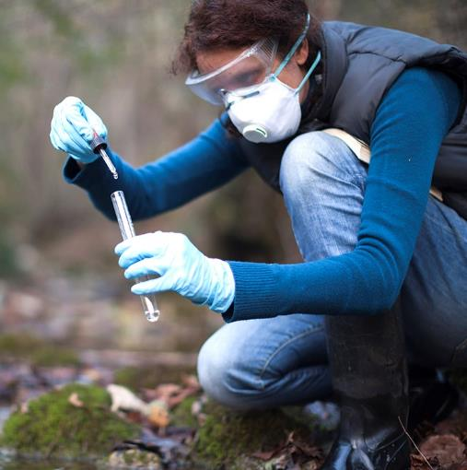
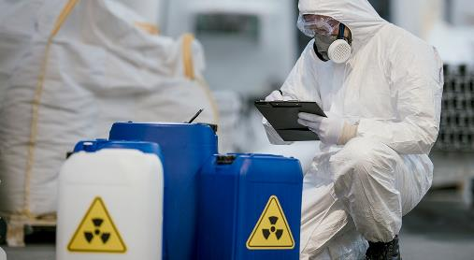
About BCSP
MISSION
We inspire and develop leaders in, health, and environmental
practice through globally accredited certification; enhancing
careers, advancing the profession, protecting people.
VISION
A safer world through
safety, health, and
environmental leadership.
CORE VALUES
BCSP – Be respectful, Create positive cultures,
Serve as leaders, Protect others
Notes:
Since 1969, the Board of Certified Safety Professionals (BCSP) has been setting and certifying the technical competency criteria for safety, health, and environmental practitioners.
In that time, many joined us as pioneers, improving safety practice by meeting the challenge of achieving and maintaining quality, accredited safety certification—The Gold Standard.
As BCSP begins the second half of our first century as an organization, what we have built has rewarded us with many new and exciting opportunities to advance safety. As we head into the future, we will ensure no one is left behind. BCSP will continue to create the path forward.

Slide 20
About BCSP:
8 Endorsing Organizations
AIHA® - American Industrial Hygiene Association® (1974)
ASSP - American Society of Safety Professionals (1974)
IISE - Institute of Industrial and Systems Engineers (1994)
ISSS - International System Safety Society (1977)
NESHTA - National Environmental, Safety and Health Training Association (2012)
NFPA - National Fire Protection Association (2007)
NSC - National Safety Council (1994)
SFPE - Society of Fire Protection Engineers (1984)
Notes:
These organizations ensure that governance of BCSP includes broad representation from across the safety profession.
Affiliated endorsing organizations nominate individuals to serve on the BCSP Board of Directors. These organizations do not provide funding or support to BCSP or its operations. They do provide their members with a variety of member services, including journals, conferences, continuing education courses, books, and many other valuable services for safety professionals.
The current affiliated endorsing organizations are listed along with the year in which they began their participation with BCSP.

Slide 21


Training from the source
Your path to success
Industry leading instructors
examCORE.ORG
Notes:
CSP, SMS, ASP, OHST, and CHST available now. $999 for 6 months access
Each training includes: 40+ subject areas, 1000+ questions
STS and STS available now. $499 for 6 months access.
Each training includes: 30+ subject areas, and 500+ questions
CIT available now. $699 for 6 months access.
Includes: 30+ subject areas, and 700+ questions
ASP + CSP examCORE Connect gives access to both training courses. $1,899 for 9 months access. Connect training includes: 40+ subject areas, 2,000+ questions

Slide 22



Questions?

Slide 23
Thank you!
Presenter:
Title:
Company:

