Slide 1
Value of Certification:
The Occupational Safety and Health Professional
Presenter:
Title:
Company

Slide 2
Overview
About BCSP
What is certification?
Why is certification important?
Benefits of certification to your career and income
Understanding the importance of accreditation
Identifying the right BCSP certification for you
BCSP certifications and promoting safety culture

Slide 3
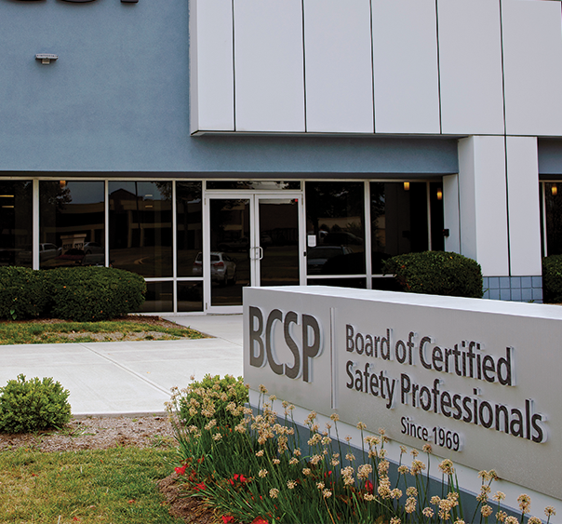
About BCSP
Established in 1969
Not-For-Profit —
headquartered in Indianapolis, IN
9 – 14 Directors on the Board
Not a membership organization
Internationally Recognized
Notes:
Headquartered in Indianapolis, IN, USA, the Board of Certified Safety Professionals (BCSP) is a not-for-profit corporation recognized as a leader in high-quality, accredited credentialing for safety, health, and environmental (SH&E) practitioners.
BCSP currently offers 8 certifications and recently celebrated 50 years of excellence in safety credentialing. These certifications are designed to set and certify technical competency criteria for SH&E practitioners worldwide. Together, we can create a safer world through safety, health, and environmental leadership.

Slide 4


About BCSP
MISSION
We inspire and develop leaders in, health, and environmental
practice through globally accredited certification; enhancing
careers, advancing the profession, protecting people.
VISION
A safer world through
safety, health, and
environmental leadership.
CORE VALUES
BCSP – Be respectful, Create positive cultures,
Serve as leaders, Protect others
Notes:
Since 1969, the Board of Certified Safety Professionals (BCSP) has been setting and certifying the technical competency criteria for safety, health, and environmental practitioners.
In that time, many joined us as pioneers, improving safety practice by meeting the challenge of achieving and maintaining quality, accredited safety certification—The Gold Standard.
As BCSP begins the second half of our first century as an organization, what we have built has rewarded us with many new and exciting opportunities to advance safety. As we head into the future, we will ensure no one is left behind. BCSP will continue to create the path forward.

Slide 5
About BCSP:
8 Endorsing Organizations
AIHA® - American Industrial Hygiene Association® (1974)
ASSP - American Society of Safety Professionals (1974)
IISE - Institute of Industrial and Systems Engineers (1994)
ISSS - International System Safety Society (1977)
NESHTA - National Environmental, Safety and Health Training Association (2012)
NFPA - National Fire Protection Association (2007)
NSC - National Safety Council (1994)
SFPE - Society of Fire Protection Engineers (1984)
Notes:
These organizations ensure that governance of BCSP includes broad representation from across the safety profession.
Affiliated endorsing organizations nominate individuals to serve on the BCSP Board of Directors. These organizations do not provide funding or support to BCSP or its operations. They do provide their members with a variety of member services, including journals, conferences, continuing education courses, books, and many other valuable services for safety professionals.
The current affiliated endorsing organizations are listed along with the year in which they began their participation with BCSP.

Slide 6


About BCSP:
Credentialing Leader
History of excellence
Exceptional standards of governance
Integrity in exam process
International recognition
Maintains highest standards of accreditation
50,000+ active certifications/designations
in 108 countries
Notes:
BCSP is recognized as the leader in high-quality credentialing for safety, health, and environmental practitioners.
BCSP establishes standards for and verifies competency in professional safety practices and evaluates certificants for compliance with recertification requirements.
One of the longest-running professional credentialing bodies for SH&E professionals in the world
CRSP- 1976
IOSH didn’t begin issuing Chartered S&H Practitioner Status until 2005
Only ABIH is older than us (first CIHs issued in 1952)
History
Established in 1969
More than 58,000 credential holders across 108 countries since 1969
Not-For-Profit — headquartered in Indianapolis, IN
Mission-driven: We inspire and develop leaders in safety, health, and environmental practice through globally accredited certification; enhancing careers, advancing the profession, protecting people
Vision: A safer world through safety, health, and environmental leadership.
Standards of Governance
9 - 14 Member Board of Directors
8 Sponsorship Organizations to ensure governance of BCSP includes broad representation from across the safety profession
AIHA, ASSP, NSC, NFPA, SFPE (Society of Fire Protection Engineers), IISE, ISSS, NESHTA
Integrity in Exam Process
Psychometric process:
Ensures all exams meet the highest standards when it comes to accurately reflecting the most relevant tasks, knowledge and skills required for current professional safety practice;
Ensures items are well-written, extensively reviewed, are reliable and valid
Ensures regular review occurs (revalidation)- occurs every 4-5 years
Widespread recognition
BCSP is recognized as the leader in high-quality credentialing for safety, health, and environmental practitioners.
The CSP is the “gold standard” worldwide
BCSP is actively involved internationally with defining and expanding the safety profession (will talk more about our relationships/collaborations with international safety organizations later, such as INSHPO)
Recognized by international bodies:
UN (Special Consultative Status with ECOSOC)
ISO
International safety certification boards
Accreditation: and not just any accreditation; BCSP follows the highest standards for accreditation, as set by the ISO
58,496 active certifications/designations in 108 countries around the world (as of November 30, 2021).

Slide 7
What is Certification?
CERTIFY – to attest authoritatively as meeting a standard.
Webster’s Ninth Collegiate Dictionary
Professional credential
Competency assessment
Third-party validation of the four ‘E’s
Voluntary process
Evaluates individuals against
a standard
Requires continuing education and professional development (recertification)
Notes:
Certified SH&E practitioners have met rigorous educational, experience, and examination requirements, as defined by a qualified and independent certification body, necessary for the protection of worker safety and health.
Also discuss here what it is NOT (license to practice, permanent, membership, certificate of completion)
4 E’s: Education, Experience, Examination and Ethics
Competency assessment includes:
Education
Experience
Validating knowledge and capacity through evaluation
NOT the same as a certificate= a document declaring that one has fulfilled requirements and was in attendance.
i.e.: snapshot in time
Example: at the end of a seminar or class, a participant receives a certificate which verifies you attended this event.
certification= credential of the safety professional
To get a certification, you must pass a test that validates your knowledge
BCSP exams are developed BY safety professionals, FOR safety professionals
Is ongoing; requires continuing education (recertification requirements)

Slide 8
What is Certification?
IT IS NOT:
License to practice
Permanent
Membership
Certificate of completion
Notes:
NOT the same as a certificate= a document declaring that one has fulfilled requirements and was in attendance.
i.e.: snapshot in time
Example: at the end of a seminar or class, a participant receives a certificate which verifies you attended this event.
certification= credential of the safety professional
To get a certification, you must pass a test that validates your knowledge
BCSP exams are developed BY safety professionals, FOR safety professionals
Is ongoing; requires continuing education (recertification requirements)

Slide 9
CERTIFICATION | CERTIFICATE
Results from an assessment process | Results from an educational process
Typically requires some amount of professional experience | For newcomers and experienced professionals alike
Awarded by a third-party, standard-setting organization | Awarded by a training and educational programs or institutions
Indicates master/competency, as measured against a defensible set of standards, usually by application or examination | Indicates completion of a course or series of courses with a specific focus
Typically results in a designation to use after one’s name | Usually listed on a resume detailing education
Has on-going requirements (recertification/continuing education) to maintain; holder must demonstrate he/she continues to meet requirements | Is the end result; individual may or may not need to demonstrate knowledge of course content at the end of a set period of time
Notes:
Certification
Results from an assessment process
Typically requires some professional experience
Awarded by a third-party, standard-setting organization
Indicates master/competency as measured against a defensible set of standards, usually by application or exam
Standards set through a defensible, industry-wide process (job analysis/role delineation) that results in an outline of required knowledge or skills
Typically results in a designation to use after one’s name; may result in a document to hang on the wall or keep in a wallet
Has on-going requirements to maintain; individual must demonstrate knowledge of content; must continue to meet requirements
Certificate
Results from an educational process
For newcomers and experienced professionals alike
Awarded by training and educational programs or institutions
Indicates completion of a course or series of courses with a specific focus; is different than a degree granting program
Course content set a variety of ways (faculty committee; dean; instructor; occasionally through defensible analysis of topic care)
Usually listed on a resume detailing education; may result in a document to hang on the wall
Is the end result; individual may or may not demonstrate knowledge of course content at the end of a set period in time

Slide 10

Why is Certification Important?
Demonstrates COMPETENCY
Advances safety PROFESSIONALISM
COMPETITIVE advantage
Demonstrates CREDIBILITY
Sets STANDARDS
PAY and mobility
Contract QUALIFICATIONS
Notes:
GENERAL
Hiring Preferences and Salary Increases: Advertisements for safety professionals often identify the CSP certification or other BCSP credentials as a desired or required qualification along with education and experience. Human resource managers and those hiring people for government positions depend on professional certification to ensure candidates have met minimum qualifications.
Enhance Your Self-Esteem: The most frequent reported value derived from achieving a BCSP credential is increased self-esteem and personal satisfaction. Most newly-certified individuals report that achieving their certification increases their personal worth. A major factor is having met standards established by peers for professional safety practice. It indicates that you have risen above the competition because you have been evaluated by professional peers against those standards.
Share Your Knowledge for Professional Safety Practice: Having achieved a certification shows you have mastered the core knowledge required for professional safety practice. The Safety Salary Survey shows that the certification process provided them with appropriate qualifications in the field. The certification did what it is intended to do - ensured the knowledge necessary for practice.
Gain an Advantage Over Your Peers: Due to the high quality of BCSP credentials, as demonstrated by its compliance with national and/or internationally recognized standards for certification of persons, most holding a BCSP credential have created an edge for themselves. As recognition for BCSP credentials grow among employers, government agencies, peers, and the public; those holding one have a competitive advantage for safety positions and assignments.
Raises Bar
Levels Playing Field
Provides Benchmark
Benefits for employers:
Helpful in selecting qualified safety professional
Improves safety in the workplace through increased competence and confidence
Increases public confidence in the employer’s safety program
Enhances profitability and quality by reducing accidents, illnesses, and insurance claims

Slide 11
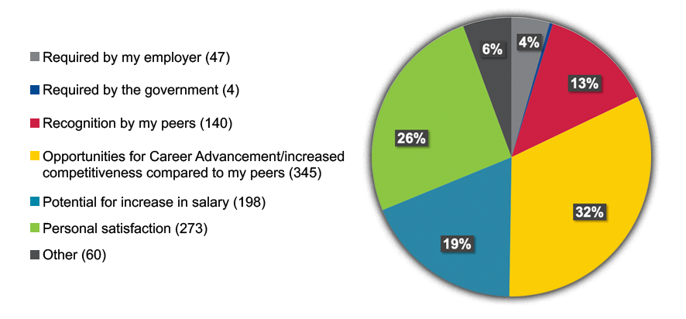
Reasons to Become Certified
Notes:
ASSP conducted a lightening poll of 508 attendees at the ASSP PDC 2019 in New Orleans, LA in June.
The numbers in parentheses represent the total number of responses.

Slide 12


Salary Survey 2020
Joint effort led by BCSP and National Safety Council (NSC)
9,225 responses
Median annual base salary: $98,000
Findings:
Certified SH&E professionals typically earn $17,700 MORE
per year than those with no licenses or certifications
CSP is higher: $27,700 more per year*
Notes:
The sample represented 42,753 BCSP active certification holders and 20,311 NSC members; response rate was 15% (total responses= 9,225)
Full-time SH&E professionals with at least one of the 14 SH&E licenses/certifications included in the survey (ASP, CDGP, CHMM, CHMP, CHST, CIH, CIT, CSP, GSP, OHST, SMS, STSC, STS, and/or TSP) typically earn about $17,700 more per year than those with none of these licenses/certifications.
CSP certification most positively correlates with salary, adding $27,700 to the median compared with the salaries of those who have none of the 14 licenses/certifications.

Slide 13
What is Accreditation?
Accreditation — the formal recognition by an independent body, generally known as an accreditation body, that a certification body operates according to international standards
International Organization for Standardization (ISO)
Why it’s important:
Protects integrity of individual certification programs
Ensures validity of certifications’ development and revalidation
Enhances authority of certification body
Promotes public confidence in the competence of individual certificants
Notes:
Another way of saying this: accredited certifications, and the credentialing organizations that maintain them, consistently meet specific requirements proving their competence, credibility, and impartiality.
In much the same way that certification validates an individual’s technical/professional competencies, accreditation evaluates the competence of a credentialing body to develop and maintain certifications.
- https://www.standardsportal.org/usa_en/resources/usaccreditation_bodies.aspx

Slide 14
What is Accreditation?
Accreditation Assures
Governance
  Nominations/elections
  Peer participation
  Public participation
Financial disclosure
  Stability and financial condition
  Budget details
Fairness to candidates
Examinations
  Validity
  Reliability
  Passing scores
Recertification
Independence from preparation
Management systems
Notes:
You cannot simply BUY an accredited credential
Speaks to process of accreditation and requirement for continuous improvement (will be discussed later in presentation under “recertification”)

Slide 15

What is Accreditation?
Not all Accreditations are
Created Equal
Content of standards
Evaluators of applications
Training of evaluators
Depth of evaluation

Slide 16
Accreditation Organizations for Personnel Certification Bodies
Accrediting Body | Accreditation Standard | SH&E-related certifications*
ANSI National Accreditation Board (ANAB) | ISO/IEC- 17024 | 17
*refers to certifications that are accredited by the body and to the standard represented in its corresponding row
Notes:
*note that the following lists refer to accredited certifications; there are many thousands more un-accredited certifications. All information provided valid as of November 2021:
ANAB: https://anabpd.ansi.org/Accreditation/credentialing/personnel-certification/ALLdirectoryListing?menuID=2&prgID=201&statusID=4
- 219 accredited certifications from 72 certification bodies
The 17 safety certifications accredited by ANAB are:
ASP
CSP
SMS
OHST
CHST
STS
STSC
CIT
Certified Industrial Hygienist (CIH)- American Board of Industrial Hygiene (ABIH)
Certified Dangerous Goods Professional (CDGP)- Institute of Hazardous Materials Management (IHMM)
Certified Hazardous Materials Manager (CHMM)- IHMM
Certified Hazardous Materials Practitioner (CHMP)- IHMM
Certified Safety Director (CSD) –NASP/IASP, Inc.
Master Safety Professional (MSP) – NASP/IASP, Inc.
Certified Fire Protection Specialist (CFPS)- National Fire Protection Association
Certified Risk Management Professional (CRMP)- Risk and Insurance Management Society (RIMS)
Safety Certification for Transportation Project Professional (SCTPP)- American Road & Transportation Builders Association
Commonly-sited international accreditation bodies:
Standards Council of Canada (SCC): 4 accredited bodies for personnel certification; 6 accredited certification programs
only 1 related to SH&E: Canadian Registered Safety Professional (CRSP) from BCRSP, with whom BCSP has a MOU reciprocal agreement
Joint Accreditation System of Australia and New Zealand (JAZ-ANZ): only 5 bodies accredited for personnel certification, 5 certifications; none related to safety
United Kingdom Accreditation Services (UKAS)- accredits to ISO standards (including 17024) and EU standards
National Accreditation Board for Certification Bodies (NABCB), India- accredits to the ISO/IEC 17024 Standard
No accredited personnel certification bodies currently listed on the NABCB website; so safety professionals in India will need to look for certifications accredited to ISO standards by accreditation bodies in other countries (i.e.: ANAB)

Slide 17
Accredited vs.
Non-Accredited Certifications
300+ Safety Certifications Available
Total Accredited SH&E Programs by ANAB: 17
8 of the 17 are BCSP’s!*
*All BCSP certifications are accredited by the ANSI National Accreditation Board (ANAB) under their personnel certification program to the ISO/IEC 17024 standard.
Notes:
No other safety certification (CSP) holds the same level of demand by employers and government agencies.
No other safety credential has the same impact on salary.
All BCSP certifications are accredited by the ANSI National Accreditation Board (ANAB) under their personnel certification program to the ISO/IEC 17024 standard.
The CSP and ASP certifications' educational requirements can only be met by educational institutions that hold institutional accreditation. There are two organizations that set standards for accrediting bodies. One is the U.S. Department of Education. The other is the Council for Higher Education Accreditation (CHEA).
To ensure this standard, BCSP requires that degrees from colleges and universities outside the United States be evaluated for U.S. equivalency

Slide 18
Accredited vs.
Non-Accredited Certifications
Certified Industrial Hygienist (CIH)
Certified Dangerous Goods Professional (CDGP)
Certified Hazardous Materials Manager (CHMM)
Certified Hazardous Materials Practitioner (CHMP)
Certified Fire Protection Specialist (CFPS)
Certified Risk Management Professional (CRMP)
Certified Safety Director (CSD)
Master Safety Professional (MSP)
Safety Certification for Transportation Project Professional (SCTPP)
Notes:
These are the other 9 accredited safety certifications available
Certified Safety Director (CSD) –NASP/IASP, Inc.
Master Safety Professional (MSP) – NASP/IASP, Inc.

Slide 19








BCSP Certifications
Certified Safety
Professional ®
Associate Safety
Professional ®
Safety Management Specialist ®
Occupational Hygiene and
Safety Technician™
Construction Health and
Safety Technician ®
Safety Trained Supervisor ®
Safety Trained Supervisor Construction ®
Certified Instructional Trainer
Notes:
Headquartered in Indianapolis, IN, USA, the Board of Certified Safety Professionals (BCSP) is a not-for-profit corporation recognized as a leader in high-quality, accredited credentialing for safety, health, and environmental (SH&E) practitioners.
BCSP currently offers 8 certifications and recently celebrated 50 years of excellence in safety credentialing. These certifications are designed to set and certify technical competency criteria for SH&E practitioners worldwide. Together, we can create a safer world through safety, health, and environmental leadership.

Slide 20

Four Types of Certification
Professional
Management
Technician and Supervisory
Training
Notes:
How do I know if there is a BCSP credential that is right for me?
Each certification is designed for a specific job level/role across all the different levels and specialties of safety practice.
BCSP certifications can be earned with varying levels of experience and/or education.
No matter where you are in your SH&E journey, there’s a BCSP credential right for you!
Benefits of earning a BCSP certification
Certifications can be used as a pathway for career advancement.
BCSP certification can lead to promotions and higher earnings (safety salary survey https://www.bcsp.org/resources/salary-survey)
All certifications are designed for SH&E practitioners

Slide 21





Professional
Certifications
and
Designations
Certified Safety
Professional ®
Associate Safety
Professional ®
Transitional Safety Practitioner
Graduate Safety Practitioner ®
Notes:
The Certified Safety Professional (CSP) is the “Gold Standard” of safety certification and has been in operation for 50 years with over 40,000 CSPs certified during that time. The CSP is BCSP’s foundational certification and holds the highest esteem amongst the SH&E community.
As of November 30, 2021:
-21,584 people hold the CSP worldwide
-6,671 people hold the ASP worldwide
-6,876 people hold the GSP
-781 people hold the TSP
Professional safety experience differs from general safety experience in the degree of responsibility.
Professionals must typically defend methods used to identify, control and manage risk.
Typically, company and department leaders rely on their analysis and recommendations relating to safety and health issues.
Many in professional positions supervise others involved in safety and health programs.
Responsibilities often involve planning, organizing, and budgeting for safety and health programs and overseeing their implementation.
Responsibilities extend well beyond compliance with safety and health regulations and standards, and often involve incorporating safety in company cultures, work practices, and profits.
Differences between each:
The Graduate Safety Practitioner (GSP) is a designation available to safety degree graduates from degree programs which meet BCSP Qualified Academic Program (QAP) standards. The GSP program is an alternate path to the Certified Safety Professional (CSP) and does not replace other paths. The GSP is not a certification.
The Transitional Safety Practitioner (TSP) is a designation available to individuals who complete a program which meets BCSP Qualified Equivalent Program (QEP) standards. The TSP is an alternate path to the CSP and does not replace other paths. The TSP is not a certification.
The primary difference between the ASP and CSP is the experience requirement: CSP candidates must have at least four years of substantive experience performing SH&E, while the ASP requires 1. The ASP is a “stepping-stone” to the CSP.

Slide 22



Safety Management
Certification
Validates the experience of safety practitioners with more than 10 years of experience, with or without
a college degree
Safety Management Specialist ®
Notes:
1,584 people have successfully obtained the SMS certification (as of November 30, 2021).
This certification is for individuals with management skills required for a business’s safe operation, such as defining and utilizing an organization’s safety management systems and identifying the business case for safety.
The primary qualification is linked to experience, with or without a college-level degree.
The exam for this certification tests skills at a different level (than say ASP or CSP)
SMS is at a higher management level: more emphasis on the breadth of responsibilities related to effective safety management, less emphasis on technical safety competencies
Breadth of responsibilities
Senior managers with safety responsibilities could certainly benefit from this certification)
Competency Assessment focused on:
Safety Management Systems
Risk Management
SH&E Concepts
Incident Investigation and Emergency Preparedness
Business Case of Safety

Slide 23
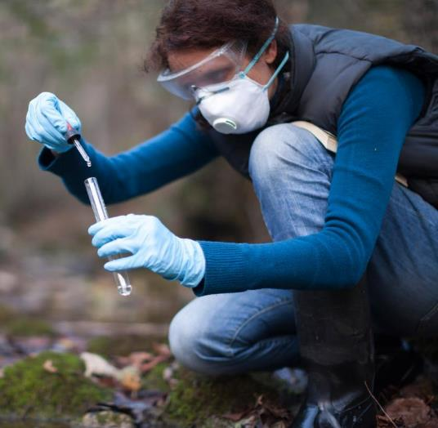




Technician and Supervisory Certifications
Occupational Hygiene and Safety Technician™
Construction Health and Safety Technician ®
Safety Trained Supervisor ®
Safety Trained Supervisor Construction ®
Notes:
BCSP awards technician and supervisory SH&E certifications that provide career paths for safety practitioners.
As of November 30, 2021:
CHST: 9,214
OHST: 1,972
STS: 2,224
STSC: 6,623
People at the technical level:
Typically have either considerable safety and health training through a series of courses or have an associate degree or higher.
May have part-time or full-time safety and health responsibilities.
For small companies, safety is often assigned to an employee who also has other job functions for the company or within a work unit.
They are making work site assessments to determine risk, identifying potential hazards and recommending controls, evaluating risks and hazard control measures, investigating accidents, maintaining and evaluating incident and loss records, and preparing emergency response plans.
Typically conduct safety, health and environmental training for employees.
People at the supervisory level:
Receive training through employer-sponsored or supported courses.
This training typically extends beyond the safety of a particular craft or job function to more general safety or workplaces, conditions and practices.
Are often involved in safety and health activities by serving on department, plant, or union-safety committees.
Have responsibility for coworkers under their direct supervision.
Only one other accredited certification exists for SH&E practitioners at the technologist, technician and supervisory levels through ANAB and ICE.

Slide 24



SH&E Training
Certification
BCSP offers an SH&E Trainer certification that provides additional career paths to professional trainers.
Certified Instructional Trainer
Notes:
967 individuals currently hold the CIT certification (as of November 30, 2021).
The CIT is held by those with experience and expertise in developing, designing, and delivering SH&E training.
Apart from formal education, trainers generally possess-whether from education, training or aptitude- a talent for imparting knowledge and skills to others.
- Those interested in becoming a competent trainer must learn the theory and practice of adult education (instructional technology).
Trainers must be thoroughly experienced and knowledgeable in the technical or scientific areas in which they teach. SH&E knowledge provides credibility and the advanced knowledge needed to understand and answer questions by those they teach- who often have years of experience in the field themselves.

Slide 25

Active
Certifications
CSP | 21,584
SMS | 1,584
ASP | 6,671
OHST | 1,972
CHST | 9,214
STS | 2,224
STSC | 6,623
CIT | 967
GSP | 6,876
TSP | 781
Notes:
Total Certifications/Designations: 58,496
*Numbers are as of November 30, 2021

Slide 26
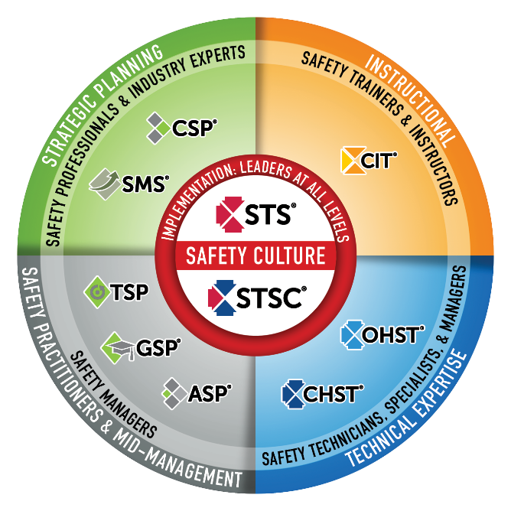

Safety Culture
BCSP fulfills industry and global demand
for validating highly competent safety practitioners with varying amounts of formal education and significant amounts of experience.
BCSP certifications create a unified safety culture by setting baseline competencies of safety knowledge and skills throughout the organization.
The best safety cultures require safety competency across the organization and also value safety leadership at all levels.
Notes:
BCSP Safety Certification Continuum
This graphic is a good way to convey the differences between BCSP’s certifications. It shows the correlation between each and in which fields the credentials are most useful.
BCSP credentials create a unified safety culture by setting baseline competencies of safety knowledge and skills throughout organizations.
The need for safety exists at all levels of an organization. The best safety cultures require safety competency across the organization and value safety leadership at all levels.

Slide 27
Application Fee Waivers
Government employees: Those presently employed by any level of government in the U.S. (federal, state, or local) including state universities and colleges
  Required documentation: current employment letter on organizational letterhead, signed by employer
Faculty (International included): Teach safety or safety-related course(s) at a college or university
  Required documentation: Teaching assignment verification with information on course(s), instructional responsibility, and semester/term from
  department officials*
*Accredited by the U.S. Department of Education or Council for Higher Education Accreditation,
or equivalent accreditation for non-U.S. colleges and universities
Notes:
Find all the information you’ll need on our App Fee Waiver pamphlet: https://www.bcsp.org/Portals/0/Assets/DocumentLibrary/App-Fee-Waiver.pdf

Slide 28

Application Fee Waivers
(continued)
U.S. Military and veterans: Active duty, reserve component
personnel, or veterans
  Required documentation: a copy of official orders,
  official DD 214 discharge papers, or military ID
  Non-transferrable
Used for any new BCSP certification
Notes:
Find all the information you’ll need on our App Fee Waiver pamphlet: https://www.bcsp.org/Portals/0/Assets/DocumentLibrary/App-Fee-Waiver.pdf

Slide 29
Exam Fee Waivers
Faculty (International included)
  Faculty of QAPs and QEPs may waive the ASP and CSP exam fees one (1) time per certification in the first six (6) months following publication of their program's becoming a QAP or QEP.
Military and Veteran
  Exam fee may be reimbursed by the U.S. Department of Veterans Affairs under various entitlement programs
Notes:
The military/veteran brochure is located at: https://www.bcsp.org/Portals/0/Assets/DocumentLibrary/LC_brochure.pdf

Slide 30

Military Benefits
Department of Defense (DoD) Credentialing Opportunities On-Line (COOL)
  Each branch has its own COOL program providing financial assistance
Army Credentialing Assistance Program
  Application fees and exam fees
  BCSP examCORE pre-exam trainings
  Annual renewal fees
  BCSP recertPRO
TSP designation for those with the CP-12
Extension and/or Leave of Absence while maintaining certification
PearsonVUE Testing Centers on military bases around the globe
Notes:
More information on these programs can be found at bcsp.org.

Slide 31
Group Management
INVEST IN SAFETY FOR YOUR WHOLE ORGANIZATION
Cover fees for employee/member pursuit of BCSP certifications and designations
Ensure a high standard of safety throughout all levels
Company name and website link on BCSP website
PROVEN EFFECTIVE
Eldeco, Inc
31% reduction in injuries
50% decrease in overall workers compensation claims costs
Nicholson Construction
Reduced company’s total recordable rate from 10.27 to 1.66 over 5 years
Hensel Phelps
Recordable incident rate ½ the industry average
Notes:
Any organization such as a union, construction firm, project owner or government agency, can join Group Management. Organizations who joined Group Management say it has given them a competitive edge and helped promote safety awareness and training.
Group Account Managers (GAMs) will be able to pay for exams, exam bundles (which include self-assessments), and all other products and services. BCSP examCORE, recertPRO, and stand-alone online self-assessments are currently excluded.

Slide 32

BCSP Giving
BCSP Foundation
  Established in 2018
  Investing to create and grow a safer global
  community; protecting those we serve
  www.bcspfoundation.org
In 2020, BCSP provided $193,352 total funding to:
  QAP student scholarships
  QAPs’ accreditation
  ASSP, AIHF, and AGC scholarships
Notes:
Breakdown of 2020 giving:
27, $5,000 student scholarship awards
6, Accreditation Assistance gifts (to those QAPs seeking accreditation or going through re-accreditation) totaling $28,352.50
2/$5,000 scholarships each to ASSP, AIHA, and AGC

Slide 33

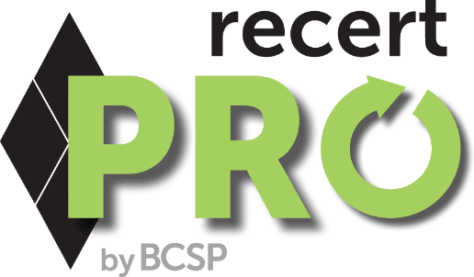
An online platform for certification
holders to earn recertification points!
recertPRO.COM
Notes:
BCSP recertPRO is a new, affordable way to earn BCSP recertification points from the convenience of your own computer or mobile device--giving you a convenient way to earn recertification points on your own schedule!
BCSP recertPRO is available for an annual subscription of $499.
BCSP recertPRO combines Challenge Tests, the KSA Quest (Knowledge, Skills, and Abilities Quest), and Journal Quizzes into a responsive website for an opportunity to achieve 6.85 recertification points per year:
0.1 points per Journal Quiz, with 41 available, for 4.1 points total.
0.25 points per KSA, with five (5) available, for 1.25 points total.
A set of 1-point and 0.5-point Challenge Tests, for 1.5 points total.

Slide 34


Now Offering an
Exam Bundle!
REDUCE STRESS
WITH A 2ND CHANCE TEST!
Exam bundles include an examination authorization, an online
self-assessment, and a second exam attempt if the first is unsuccessful for one reduced price.
Apply Today @
Notes:
Applicants who are exam-eligible may select "Purchase Exam" and choose to buy an exam bundle.
CSP, SMS, ASP: Exam $350. Bundle $600.
OHST, CHST: Exam $300. Bundle $550.
STS, STSC: Exam $185. Bundle $325.
CIT: Exam $300. Bundle $500
-Each examination authorization is good for an exam sitting, is non-transferable and non-refundable.
-You must have at least thirteen (13) weeks left on your eligibility time clock to purchase the Exam Bundle.
-Applicants must wait a six (6) week period between exam attempts if a second attempt is needed.

Slide 35


Training from the source
Your path to success
Industry leading instructors
examCORE.ORG
Notes:
CSP, SMS, ASP, OHST, and CHST available now. $999 for 6 months access
Each training includes: 40+ subject areas, 1000+ questions
STS and STS available now. $499 for 6 months access.
Each training includes: 30+ subject areas, and 500+ questions
CIT available now. $699 for 6 months access.
Includes: 30+ subject areas, and 700+ questions
ASP + CSP examCORE Connect gives access to both training courses. $1,899 for 9 months access. Connect training includes: 40+ subject areas, 2,000+ questions

Slide 36



Questions?

Slide 37
Thank you!
Presenter:
Title:
Company:

