Slide 1
Career Paths
in Safety
Presenter:
Title:
Company

Slide 2

Agenda and Objectives
About the safety, health, and environmental (SH&E) profession
Careers in SH&E
Benefits of becoming an SH&E professional
Career paths/how students can enter the profession out of high school
Professional credentialing in SH&E
Notes:
We wrote a blog article (https://www.bcsp.org/About/BCSP-News/how-do-i-get-a-job-in-health-and-safety) that can help with your presentation. It explains how many people enter the SH&E profession and includes personal stories from SH&E professionals about how they got started in SH&E.

Slide 3

What is the Safety, Health, and Environmental (SH&E) Profession?
Safety = Practice of Prevention
Accidents and occupational illnesses
Damage to property and equipment
Harm to the environment
Focus of the SH&E Professional: Safety of workers and business
Notes:
A Safety Professional = an individual that has the education, experience, knowledge, and skills to practice safety management in a workplace; professionals who can help identify hazards and develop solutions to keep workers safe.
Safety, health, and environmental (SH&E) professionals prevent harm to people, property, and the environment by applying principles from engineering, education, psychology, physiology, enforcement, hygiene, health, physics, and management.
SH&E professionals use appropriate methods and techniques of loss prevention and control and work in all industries worldwide.
Safety Practice = Prevention
Prevention of incidents and accidents that may lead to injuries, illnesses, damage to property and equipment, or harm to the environment focuses on the safety of workers and businesses

Slide 4

What is the Safety Profession?
Multi-disciplinary practice
Science (chemistry, biology, environment)
Engineering (mechanical, electrical, structural, chemical)
Physics
Business and economics
Mathematics
Health
Knowledge of applicable laws and regulations
Human behavior and psychology
Education and training
Computer and internet technologies
Notes:
The safety profession is comprised of appx. 110,000 safety professionals. Safety professionals advise, develop strategies, and lead workplace safety and health management. We’ve created a magazine that describes the different fields and purposes of the safety profession (https://online.fliphtml5.com/pbcyp/nnqq/#p=1)
Safety Science:
Safety science is the term used for everything that goes into the prevention of accidents, illnesses, fires, explosions, and other events that harm people, property, and the environment.
Areas of safety science include:
Chemistry and Biology
Physics
Ergonomics
Environmental sciences
Psychology
Physiology, biomechanics and medicine
Engineering, business management, economics, sociology, and geology

Slide 5
Specializations Within
Safety Practice
Multi-disciplinary practice
Science (chemistry, biology, environment)
Engineering (mechanical, electrical, structural, chemical)
Physics
Business and economics
Mathematics
Health
Knowledge of applicable laws and regulations
Human behavior and psychology
Education and training
Computer and internet technologies
Occupational safety
Industrial hygiene
Environmental safety
Fire protection engineering
Ergonomics
Systems safety
Risk management
Loss control, loss prevention, and risk control
Chemical process safety
Construction safety
Institutional safety management
Transportation safety
Safety research and risk assessment
Product safety
Notes:
Definitions:
Occupational Safety: professionals who work in manufacturing and production operations to help ensure that working conditions and work methods are safe and healthful for employees
**nearly every large plant and industrial facility employs at least one full-time safety professional
Industrial Hygiene: specializes in workers’ exposure to chemical and physical hazards created by the industrial process
Environmental Safety: eliminating the release of materials that can harm the public or damage the environment; recovery and recycling of excess materials for environmental conservation
Three main areas for career opportunities in environmental safety:
Industrial/government sector
Consulting
Contracting
Fire Protection Engineering: use the basic tools of engineering and science to help protect people, property and operations from fire and explosions
Ergonomics: the science of fitting the job to the person
Systems Safety: work in major new technology fields; develop quality products that have a minimum potential for failure
Risk management: AKA “Risk Control”- works to reduce the likelihood and size of losses for a company
Loss control, prevention and risk control- terms primarily used in the insurance industry
Insurance companies selling workers’ compensation, property, auto, liability and other forms of business insurance employ safety professionals to conduct risk assessments to support underwriting (business selection and pricing process), and help their clients prevent incidents and accidents that lead to insurance claims
Chemical Process Safety: the analysis of chemical processes to identify the potential for accidents
Construction Safety: recognizing and controlling the wide variety of safety, health and fire hazards in constantly-changing construction work environments
**one of the largest and fastest growing areas of employment for safety professionals, since construction is one of the most hazardous industries
Institutional Management Safety: hazard control in organizations such as hospitals, correctional facilities, research facilities, or schools
Transportation Safety: railroads, trucking, auto, aviation, maritime shipping, and oil and gas pipelines
Most often requires a degree in civil or mechanical engineering
Major employers in transportation safety:
Federal government (FAA, Coast Guard, DOT, NTSB)
Private companies (airlines, railroads, large trucking firms, ONG pipeline companies)
Safety Research: Studies and contributes to growing the field of safety science
Government job opportunities: EPA, NIOSH

Slide 6
What Do Safety
Professionals Do?
A Day in the Life of an SH&E Professional
Hazard identification
Risk analysis
Development of controls and safety assessment methods
Fire protection
Environmental protection
Accident and illness investigations
Inspections/audits
Training and managing safety programs
Record keeping
Monitoring and evaluation
Product safety
Hazardous materials management
Ergonomics
Emergency response
Advising management
Notes:
-This is NOT a boring job!
-It is dynamic, constantly changing, personally, and professionally challenging.
-Individual job tasks can change from day to day.
This would be a good slide to utilize The Safety Profession magazine (https://online.fliphtml5.com/pbcyp/nnqq/#p=1) mentioned in the notes in an earlier slide. Pages 8-9 have testimonials from safety professions about what they do/how they entered the field.

Slide 7
Where Do Safety Professionals Work?
Everywhere!
Manufacturing 29%
Construction 23%
Public Administration/Government 13%
Services and Education 11%
Utilities 6%
Mining, Oil and Gas 6%
Other 12%
Notes:
Safety professionals are in nearly every industry. Hazards exist in every workplace, and where hazards exist there is a need for safety professionals. Pages 4-7 of The Safety Profession magazine (https://online.fliphtml5.com/pbcyp/nnqq/#p=1) does a good job of describing what safety roles are like across many industries.
NOT the same as a certificate= a document declaring that one has fulfilled requirements and was in attendance.
i.e.: snapshot in time
Example: at the end of a seminar or class, a participant receives a certificate which verifies you attended this event.
certification= credential of the safety professional
To get a certification, you must pass a test that validates your knowledge
BCSP exams are developed BY safety professionals, FOR safety professionals
Is ongoing; requires continuing education (recertification requirements)
*Industry data based on Safety+Health Magazine Salary Survey 2019

Slide 8

Why Become a Safety Professional?
High demand (remember the NIOSH study)
Flexibility/transferability across industries
Interesting and satisfying career
Good pay
Multiple pathways
Notes:
Safety professionals who can demonstrate their competency are in demand and receive compensation well above their colleagues. To be able to compete for positions with responsibility requires safety professionals take charge of their own professional development. Those moving to leadership positions are arming themselves with advanced degrees. In addition, safety professionals are obtaining nationally accredited and highly recognized certifications to demonstrate competency to qualify for positions, to compete for government and private contracts and to gain new clients.
Whether the career goals include seeking a new position, moving up in the current organization, or moving to private practice, one can accelerate opportunities by achieving a BCSP certification. Holding a BCSP certification enhances the chance of being selected for leadership and senior positions, as well as increased salary.
The Board of Certified Safety Professionals (BCSP) conducted the 2020 SH&E industry safety salary survey in collaboration with the National Safety Council (https://www.bcsp.org/resources/salary-survey).
We interviewed two safety professionals who were present during the aftermath of the 9/11 attacks. This would be a good way to show the importance of the profession. https://www.bcsp.org/About/BCSP-News/protecting-people-property-and-the-environment-in-the-wake-of-911

Slide 9
What Current Safety Professionals Say
ASSP PDC 2019 Lightening Poll
Notes:
ASSP conducted a lightening poll of 508 attendees at the ASSP PDC 2019 in New Orleans, LA in June.

Slide 10
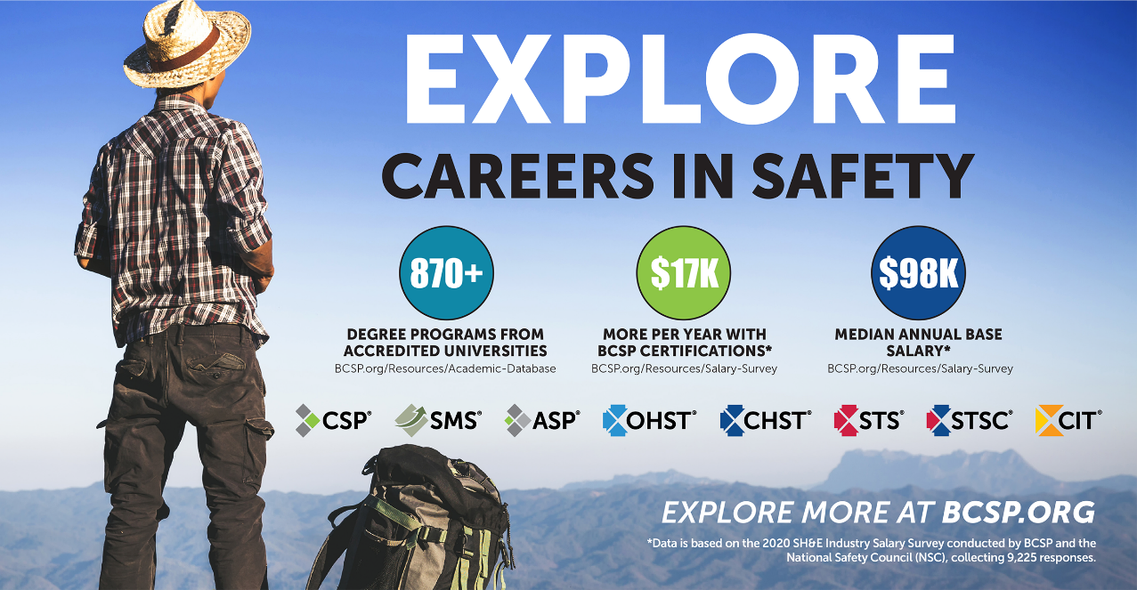

Slide 11

Choose Safety!

Slide 12
What is Certification?
CERTIFY – to attest authoritatively as meeting a standard.
Webster’s Ninth Collegiate Dictionary
Professional credential
Competency assessment
Third-party validation of the four ‘E’s
Voluntary process
Evaluates individuals against
a standard
Requires continuing education and professional development (recertification)
Notes:
Certified SH&E practitioners have met rigorous educational, experience, and examination requirements, as defined by a qualified and independent certification body, necessary for the protection of worker safety and health.
Also discuss here what it is NOT (license to practice, permanent, membership, certificate of completion)
4 E’s: Education, Experience, Examination and Ethics
Competency assessment includes:
Education
Experience
Validating knowledge and capacity through evaluation
NOT the same as a certificate= a document declaring that one has fulfilled requirements and was in attendance.
i.e.: snapshot in time
Example: at the end of a seminar or class, a participant receives a certificate which verifies you attended this event.
certification= credential of the safety professional
To get a certification, you must pass a test that validates your knowledge
BCSP exams are developed BY safety professionals, FOR safety professionals
Is ongoing; requires continuing education (recertification requirements)

Slide 13
What is Certification?
IT IS NOT:
License to practice
Permanent
Membership
Certificate of completion
Notes:
NOT the same as a certificate= a document declaring that one has fulfilled requirements and was in attendance.
i.e.: snapshot in time
Example: at the end of a seminar or class, a participant receives a certificate which verifies you attended this event.
certification= credential of the safety professional
To get a certification, you must pass a test that validates your knowledge
BCSP exams are developed BY safety professionals, FOR safety professionals
Is ongoing; requires continuing education (recertification requirements)

Slide 14

Would you
personally hire:
An accountant without CPA certification?
An engineer without a P.E. license?
A doctor, nurse, lawyer, or teacher without board certification?
A safety practitioner to protect
your workforce without accredited board certification?
Notes:
You remember those salary numbers I showed you earlier? Using the same 2020 salary survey data and calculator, we have found that there is a significant advantage to being a certified safety professional (both in terms of financial compensation and competitiveness in the job market).- see next slide

Slide 15


Salary Survey 2020
Joint effort led by BCSP and National Safety Council (NSC)
9,225 responses
Median annual base salary: $98,000
Findings:
Certified SH&E professionals typically earn $17,700 MORE
per year than those with no licenses or certifications
CSP is higher: $27,700 more per year*
Notes:
The sample represented 42,753 BCSP active certification holders and 20,311 NSC members; response rate was 15% (total responses= 9,225)
Full-time SH&E professionals with at least one of the 14 SH&E licenses/certifications included in the survey (ASP, CDGP, CHMM, CHMP, CHST, CIH, CIT, CSP, GSP, OHST, SMS, STSC, STS, and/or TSP) typically earn about $17,700 more per year than those with none of these licenses/certifications.
CSP certification most positively correlates with salary, adding $27,700 to the median compared with the salaries of those who have none of the 14 licenses/certifications.

Slide 16

How to Become a
Safety Professional
What your students can do now
Educational opportunities in safety
Work experience
  Safety by assignment
  Craft-to-Professional
  Safety by experience
  Safety internships/apprenticeships
Certification
Notes:
Safety and Health Degrees (next slide)
Safety by Assignment. Many people get involved in safety at various levels because their employer or union assigned them safety responsibility. The assignment may be on a safety committee, plant safety committee, as a collateral duty or part-time assignment, or as a full-time safety person. These assignments often progress in responsibility. Some may start in other roles, such as human resources, with safety as part of their job. The responsibility grows with the effort to improve safety performance and compliance.
Craft-to-Professional. A number of people begin their involvement in safety through a leadership role in their craft or work group. As a supervisor or team leader, they may have responsibility for the safety of others. Interest in advancing safety may lead to a greater safety assignment.
Safety by Experience. Sometimes people get involved in safety because they were part of a significant incident in which they or others were injured or became ill. The experience moves them to pursue safety as a career field. Roles and responsibilities may increase over time.

Slide 17

How to Become a
Safety Professional
Post-High School Education
Community and Technical College
Four-year colleges and universities
Graduate Study
Graduate Safety Practitioner® (GSP®)
Transitional Safety Practitioner (TSP )
Notes:
Example degree programs at a four-year college or university:
BS, Industrial Safety;
BS, Occupational Safety and Health;
BS, Environmental Science- Safety
Example Masters degree programs:
MS, Industrial Hygiene;
MS, Safety Management
A full list of safety-related academic programs and educational institutions can be found at https://www.bcsp.org/resources/academic-database.

Slide 18



Graduate Safety Practitioner
Designation
Available to graduates of Qualified
Academic Programs (QAPs)
Benefits:
  You meet the CSP eligibility requirement of holding a BCSP
  qualified credential, waiving the ASP and its exam
  Recognition for being on a path toward the CSP certification
  Recognition for being on a path toward the STS and STSC certifications
  Recognition for the level of preparation for professional safety practice
  A GSP digital wall certificate
  GSPs’ names and digital badges appear on the BCSP Credential
  Holder Directory
  Use of the BCSP Career Center (JOBS.BCSP.ORG) to post a resume and view career opportunities
Notes:
It is a Designation, NOT a certification
Unlike a certification, a designation:
Does not require recertification (i.e., continuing education), and
It is temporary: it is a stepping-stone to the CSP.
Scholarship: every year, the BCSP Foundation awards a $5,000 scholarship to one student enrolled full-time in an ABET accredited QAP.
About QAPs:
Curriculum mapping to ASP blueprint
QAP graduates qualify for the Graduate Safety Practitioner (GSP) designation
See next slide for more information on QAPs
Time limits:
Students graduating from a QAP must apply for the GSP within the program’s “Applicable Dates” as noted on the QAP List (found at https://www.bcsp.org/GSP). Typically a graduate must apply within one (1) year of graduation.
GSPs must have four (4) years of safety experience before applying for the CSP.
GSPs must sit for and pass the Certified Safety Professional (CSP) examination within six (6) years of the date the GSP is awarded

Slide 19

Qualified Academic
Programs (QAP)
Programs are reviewed throughout the year
and are posted to the QAP list every quarter
Curriculum mapping to ASP blueprint
QAP graduates qualify for the Graduate
Safety Practitioner (GSP) designation
The GSP Designation recognizes a graduate’s level of preparation for professional safety practice and sets them on the path toward CSP Certification
*For a current list of QAPs please visit BCSP.ORG/GSP
Notes:
A QAP is an academic degree program in safety, health and/or environmental practices meeting BCSP standards for participation and whose curriculum has been reviewed as showing a substantial match with the Associate Safety Professional (ASP).
Our list of current QAPs updates quarterly, as we regularly receive review request from prospective programs, so check our website often for updates!
Benefits of being a QAP
Being a GSP QAP distinguishes your SH&E program from other programs, recognizing graduates' accomplishments with a path to professional certification.
BCSP gives special recognition to QAPs in our Academic Database.
University faculty teaching SH&E courses may qualify for a free ASP and CSP application and free exams.
QAPs are eligible for a grant of up to $10,000 toward full accreditation or reaccreditation by the Accreditation Board for Engineering and Technology (ABET)
The BCSP Foundation provides ABET/AABI accredited QAPs with $5,000 scholarships for their students.

Slide 20
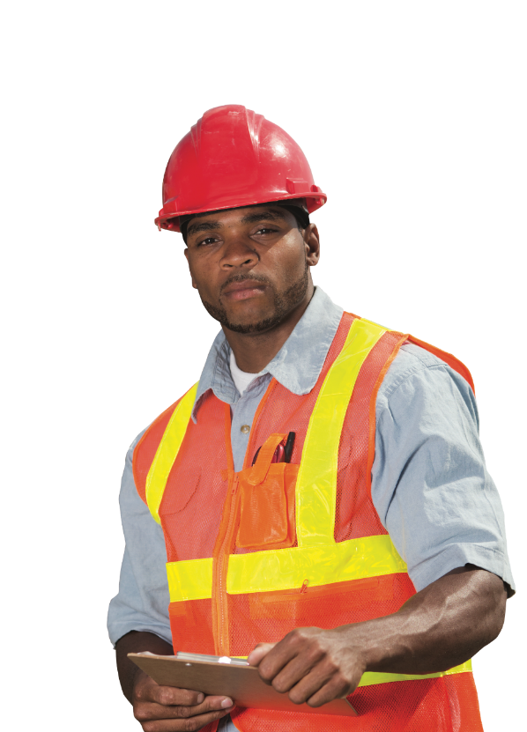

Transitional Safety Practitioner
Designation
Available to individuals of Qualified Equivalent
Programs (QEPs)
Benefits:
  You meet the CSP eligibility requirement of holding a BCSP qualified credential, waiving the ASP and its exam
  Recognition for being on a path toward the CSP certification
  Recognition for the level of preparation for professional safety practice
  A TSP digital wall certificate
  TSPs’ names and digital badges appear on the BCSP Credential Holder Directory.
  Use of the BCSP Career Center (JOBS.BCSP.ORG) to post a resume and view career opportunities
Notes:
It is a Designation, NOT a certification
Unlike a certification, a designation:
Does not require recertification (i.e. continuing education), and
It is temporary: it is a stepping stone to the CSP.
Individuals from a QEP must apply for the TSP within the program’s “Applicable Dates” as listed on the QEP list, typically one (1) year from graduation. Click the "My Profile" button at BCSP.ORG and create a profile to begin.
TSP Time Limit
TSPs must apply for and pass the Certified Safety Professional (CSP) examination within six (6) years of the date the TSP is awarded.

Slide 21


Qualified Equivalent Programs (QEP)
Eligibility:
Curriculum-based certificate, diploma
Substantial match to ASP blueprint
QEP graduates qualify for the TSP
The TSP designation recognizes an individual’s level of preparation for professional safety practice and sets him/her on the path toward CSP certification.
*For a current list of QEPs please visit BCSP.ORG/TSP
Notes:
What are the benefits of becoming a QEP?
-Being a QEP distinguishes your SH&E program from other programs.
-BCSP gives special recognition to QEPs on our website.
-Individuals who complete your QEP program and apply for the TSP designation are provided additional benefits and recognition for their advancement in safety practice.
Note our list of current QEPs updates frequently, as we regularly get application request from prospective programs, so check our website often for updates!

Slide 22

Summary
The SH&E profession is a growing field in high demand.
There are multiple paths to entering the safety profession.
Students need to be made aware of the importance of professional credentialing and life-long learning in their chosen career fields.

Slide 23


Training from the source
Your path to success
Industry leading instructors
examCORE.ORG
Notes:
CSP, SMS, ASP, OHST, and CHST available now. $999 for 6 months access
Each training includes: 40+ subject areas, 1000+ questions
STS and STS available now. $499 for 6 months access.
Each training includes: 30+ subject areas, and 500+ questions
CIT available now. $699 for 6 months access.
Includes: 30+ subject areas, and 700+ questions
ASP + CSP examCORE Connect gives access to both training courses. $1,899 for 9 months access. Connect training includes: 40+ subject areas, 2,000+ questions

Slide 24



Questions?

Slide 25
Thank You!
Presenter:
Title:
Company

